Slide 1
Guideline Updates
Dr. Hakkarinen & Dr. Hurtado
2022

Slide 2
General Notes:
Dr. Hakkarinen and Dr. Hurtado have combined their guidelines
Exceptions will be described in this training
Waivers will not apply to all agencies; pay special attention to the appendix
Waiver section will be updated when new waivers are in place
This set of guidelines will appear on app as:
Centura Agencies El Paso/Teller Counties Prehospital Practice Guidelines
Quick Reference Guide has been moved to the appendix.

Slide 3
Section A:
A003: Consent
Added new statement in special considerations: A medical provider with no previously established professional relationship with the patient has no medical authority to direct care on scene.
Contact your leadership or Medical Control through Pulsara if concerns arise.
A007: Destination
Grandview is now a level 4 trauma center. Pikes Peak Regional Health and St. Thomas Moore have been added.
Further information on Pikes Peak Regional Health is in the Appendix.
A008: Death in the field
TOR: Trauma
Resuscitation is considered futile after 10 minutes

Slide 4
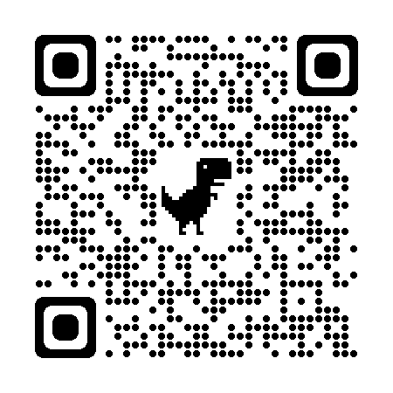
Section A:
A009: Mandatory Reporting
Adult Protective Services contact info added.
Scan this QR code to view requirements and learn more about mandatory reporting!
Medical Provider on Scene signature form removed.
(Related to A003)
A010: Waivers
Waivers are separated between medical directors.
TXA only for EPCSAR and NETCO until next Waiver cycle.
When additional waivers are obtained, there will be notification and training

Slide 5
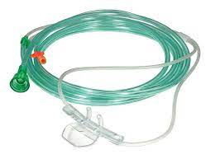
Section B:
B001: Airway
Cricothyrotomy
Pediatric age range: Provides 20 - 40 minutes of oxygenation
Use in Asthma patients if other resources are exhausted
Needle Decompression
Special considerations for depth of insertion for pediatrics: Consider 1.5 inch 14- or 16-gauge catheter
B003: Cardiac Related Procedures
Cardiac monitoring
Indications: Added seizure and brief resolved unexplained event (BRUE)
Vagal Maneuvers
Special considerations
Added “In pediatrics a bag of ice with water (easily moldable) can “be applied to the face”.
B004: Law Enforcement Blood Draw
Added for agencies who have a policy and wish to provide the service.
B006: Monitoring Devices
EtCO2 is indicated: Any patient receiving narcotics or benzodiazepines. This will be carefully monitored in QA/QI

Slide 6
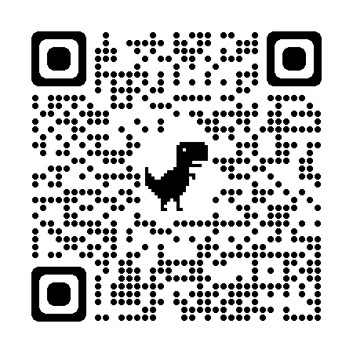
Section B:
B009: Vascular Access:
PICC lines are NOT allowed to be accessed in the field.
Added distal femur to IO approved sites.
Scan the QR code for distal femur infographic
B008:Nausea/Vomiting:
Haldol added for Gastrointestinal/Cyclical Vomiting.
B011: Miscellaneous Procedures:
Gastric Tube Insertion (Oral): EMT approved once waiver is approved.
B010: Spinal Motion Restriction:
Last box: Added document cervical clearance.

Slide 7
Section B:
B009 Pain Management:
Added ketorolac (Toradol)
ADULT: 15 mg IV/IO or 30 mg IM
PEDIATRIC > 2 YEARS: 0.5 mg/kg IV/IO/IM
MAX dose 15 mg IV/IO or 30 mg IM.
New! Spasm/Anxiety:
document which aspect you are treating
i.e. Midazolam for pain related anxiety

Slide 8
Section D: The order of cardiac disorders has changed to what you might encounter first.
D001: Acute Coronary Syndrome
New cardiac alert criteria: Modified Sgarbossa's Criteria (if LBBB or ventricular pacemaker present):
Concordant ST-segment elevation ≥ 1 mm in any lead
ST depression > 1 mm in leads v1-v3
If unsure if patient is appropriate for Pulsara Cardiac Alert, contact Medical Control for consult
AVR criteria has been taken out.

Slide 9
Section D:
D003: Tachydysrhythmias
Added amiodarone to the tachydysrhythmia guideline that is refractory to cardioversion.
Diazepam and Ativan are not in CSFD Guideline.
Cardizem dose is different than CSFD Guideline.
D007: ROSC
Changed fluid titration to 90-100mmHG.
Documentation tip: don’t forget a post ROSC 12 lead
D009: Ventricular Assist Devices
Added Fluid Therapy PRN until improved perfusion.

Slide 10
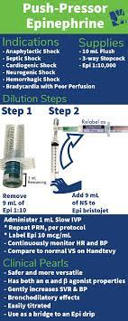
A Note on Push-Dose Epinephrine
It can be a great way to titrate specific amounts, especially with pediatrics when we don’t want to fluid overload.
A Note on Lidocaine
It can be alternative for smaller agencies or when Amiodarone is not available.

Slide 11
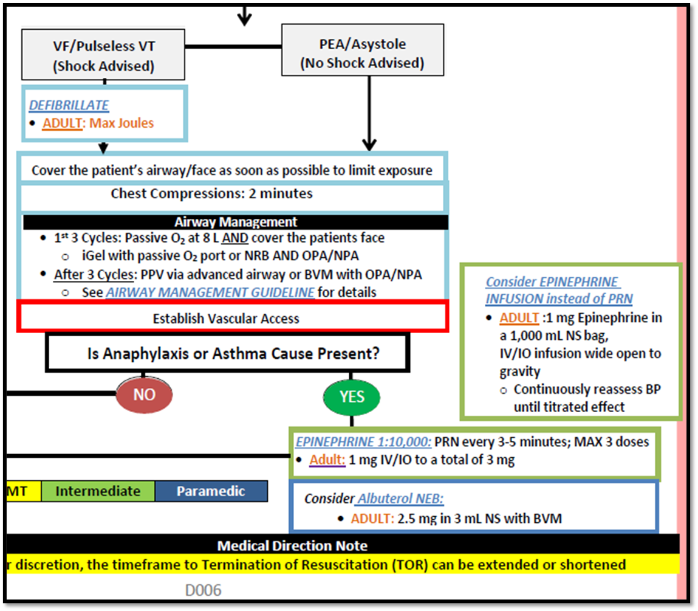
Doo6: New Cardiac Arrest (Respiratory) Guideline
To help emphasize when Epinephrine should be used in an Adult suffering from Cardiac Arrest.
When you have a high index of suspicion that it is Anaphylaxis or Asthma.
New Pulsara patient channel

Slide 12
Section E:
E001: Allergy/Anaphylaxis
Diphenhydramine moved up in the algorithm before steroids. CSFD has a different algorithm.
E003: Diabetic Emergency
Different Adult Dextrose dosing than CSFD Guideline.
10% Dextrose:
25 grams (250 mL of a 10% solution) IV/IO, slowly over 10 minutes or until patient condition improves
E004: Epistaxis
TXA will be added once waivers are approved
Currently only allowed at
EPCSAR and NETCO.
Also applies to F008: TXA for Hemorrhage
E005: OB/GYN Emergency
Pre-Eclampsia added to algorithm.
New patient channel in Pulsara

Slide 13
Section E:
E008: Seizure Medication Changes
MIDAZOLAM: PRN every 10 minutes
• ADULT: 5 mg IV/IO/IN/IM
• PEDIATRIC: 0.1 mg/kg IV/IO/IN/IM, MAX single dose of 5 mg
DIAZEPAM: PRN every 10 minutes
• ADULT: 10 mg IV/IO/IM/IN
• PEDIATRIC: 0.5 mg/kg IV/IO/IM/IN MAX single dose of 10 mg
Also, see individual drug profile for comfort measure dosages.
E010 and E11:
MSTU info left in for mutual aid areas and COVID guidance remains.

Slide 14
Section E: New Behavioral Health Guideline
Utilizes RASS scoring scale to more accurately categorize your patient and treat appropriately.

Slide 15
BONUS! New Algorithm & New patient channel in Pulsara
Droperidol dose changed
Olanzapine added
Ketamine removed

Slide 16
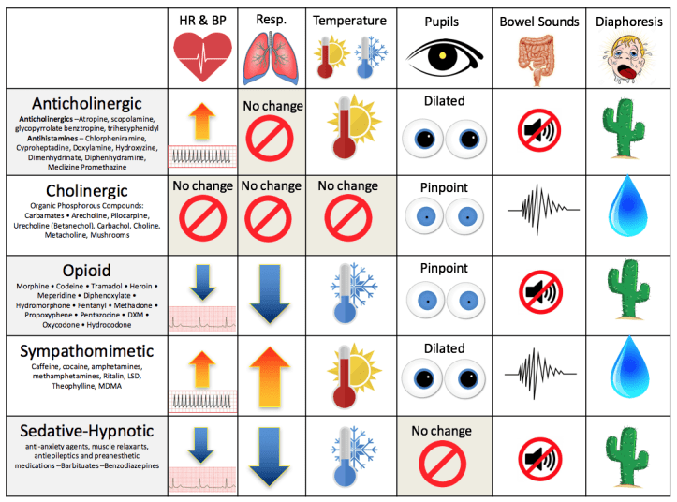
Section E007: Poisoning/Overdose Medication Changes
Sodium Bicarbonate:
ADULT and PEDIATRIC >2:
100 mEq bolus IV/IO of an 8.4% solution
In severe cases consider drip;
Mix 150 mEq (150 mL) in 1,000 mL
NS and administer at 200 mL/hr
CALCIUM CHLORIDE:
Every 10 mins to a MAX of 3 doses
• ADULT: 1 Gram slow bolus over 2 to 5 minutes IV/IO
• PEDIATRIC: 20 mg/kg slow bolus over 2 to 5 minutes IV/IO, MAX 1 Gram
CALCIUM GLUCONATE: every 10 mins to a MAX 3 doses
• ADULT: 3 Grams slow bolus over 2 to 5 minutes IV/IO
• PEDIATRIC: 60 mg/kg, slow bolus over 2 to 5 minutes IV/IO. MAX 3 Grams

Slide 17
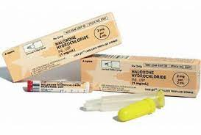
NARCAN/Naloxone:
PRN until desired effect
If patient symptoms redevelop consider repeating at last therapeutic dose
If symptoms do not improve at 4 mg, consider other causes
ADULT: Initial dose at 0.5 mg to 1 mg bolus IV/IO/IM/IN
2nd dose PRN: 1 mg to 2 mg
3rd dose PRN: 2 mg to 4 mg
PEDIATRIC:
>20 kg: 0.5 mg bolus IV/IO/IM/IN titrate up to 2 mg TOTAL
<20 kg: 0.01 mg/kg bolus IV/IO/IM/IN up to 2 mg

Slide 18
Section E:
E009: Sepsis
Pediatric fluid changed to prevent fluid overloading.
PEDIATRIC: 10 mL/kg NS IV/IO repeat up
to 2 times (30 mL/kg)
Use qSOFA criteria for Pulsara Sepsis Alert Channel

Slide 19
Section G002: Cold Emergencies
New Hypothermic Cardiac Arrest Algorithm
• No studies have identified effective pharmacological therapy for humans in the setting of hypothermic cardiac arrest a) If there is a specific indication for medication administration, administer the medication(s) • Apparent rigor mortis is NOT a contraindication to starting chest compressions in the hypothermic patient • EtCO2 is NOT a reliable guide for resuscitation in severe hypothermia a) Case series have demonstrated a significant discrepancy between ETCO2 and PaCO2 • BLS Termination of Resuscitation criteria DOES NOT apply in this patient population

Slide 20
Medication Overview
Medications have been placed in alphabetical order.
Your quick reference guide for everything has been moved to the back of the Guidelines.
NEW medications will be discussed here
all changes to medications and doses were discussed in previous slides.
The following terminology was added to Epinephrine, Sodium Bicarbonate, and Calcium:
Avoid combining or administering (listed above medication) within the same vascular access line (incompatible), it will precipitate if mixed.

Slide 21
Ancef (Cefazolin) Will be active once waiver has been approved.

Slide 22
Ketorolac (Toradol) This has been added to scope of practice in chapter 2. No longer a waivered item

Slide 23
Olanzapine (Zyprexa) Additional medication to consider for Behavioral Health patients

Slide 24
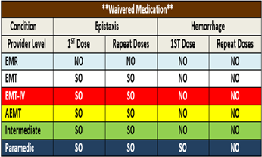
Tranexamic Acid (TXA) Will be active once waiver has been approved.

Slide 25
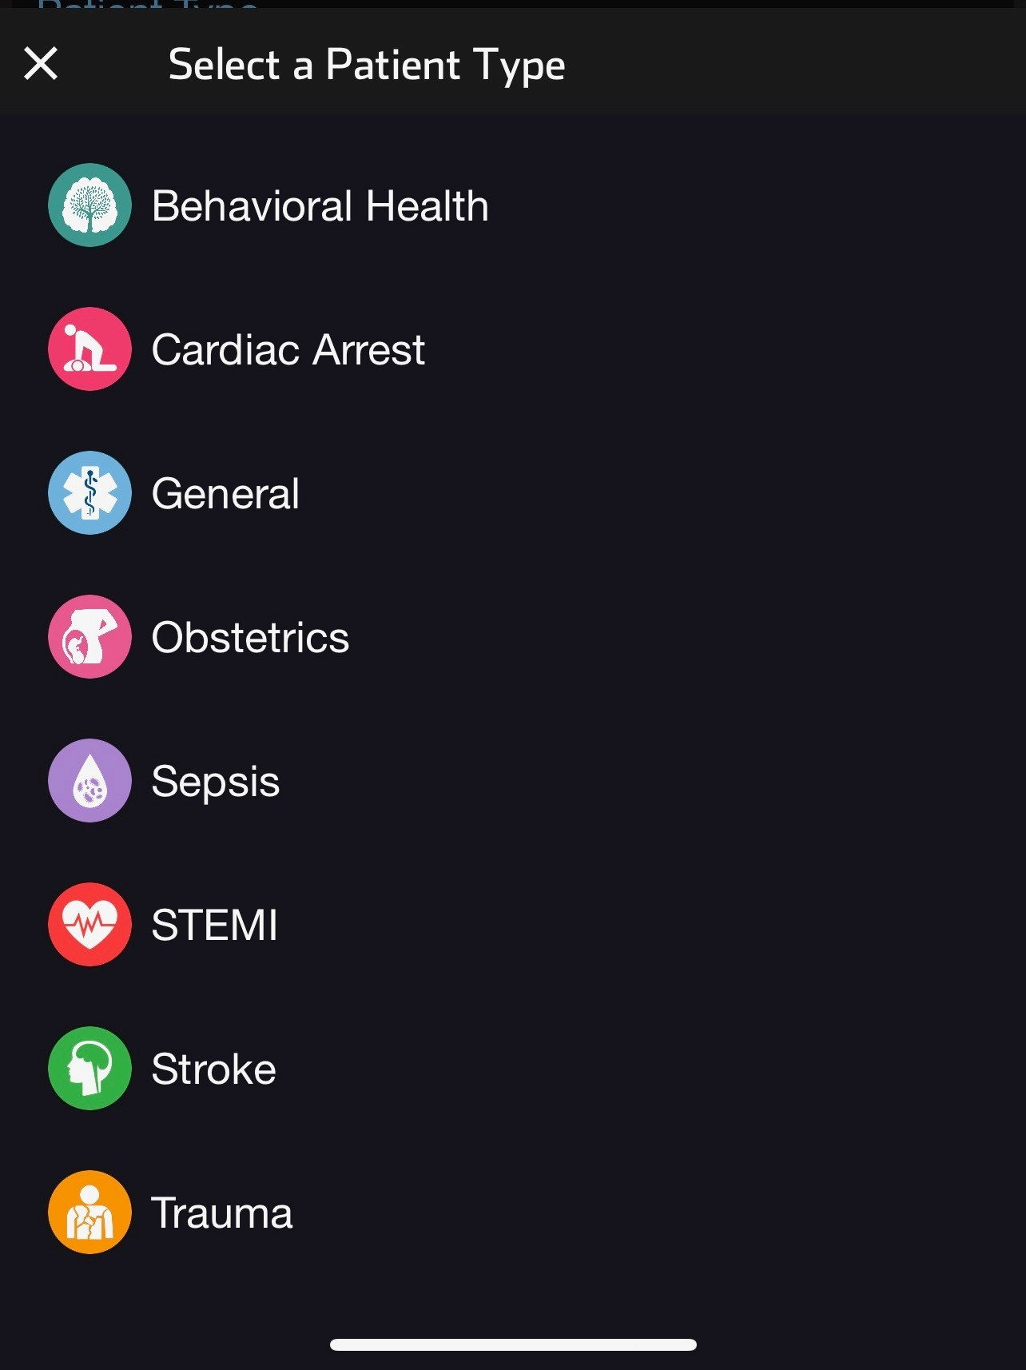
Pulsara Tip Sheets
These will be updated as versions change to help facilitate your success with communication.

Slide 26
Dr. Hakkarinen Agency Specifics
When you combine two sets of Guidelines there will be differences.
This section highlights the few Guidelines that apply to agencies who receive medical direction through Dr. Hakkarinen.
Located at the back for ease of reference.
If you are using the following GL’s, be mindful of the need for strict adherence and careful documentation.

Slide 27
If you have any questions, comments, or concerns about your new guidelines, please let us know.
Thank you for doing your part to help our region be successful.
To Contact Us:
Maureen Bradley:
maureenbradley@centura.org
Jessica Manzo:
jessicamanzo@centura.org

