Slide 1
WAIVER REVIEW
Maureen Bradley, EMS Coordinator
Common Spirit EMS Institute
DJ Head, EMS Educator
Common Spirit EMS Institute

Slide 2
OBJECTIVE:
Review of waivered medications and procedures approved by Drs Hakkarinen and Hurtado
Procedures
Joint Reduction
MAAM
OG Tube Placement
Medications
Sedatives
Paralytics
Antibiotics
Tranexamic Acid

Slide 3
JOINT REDUCTIONS: EMERGENT VS. WAIVERED

Slide 4
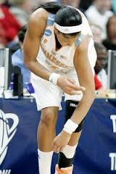
OBJECTIVES:
Compare the difference between an EMERGENT joint reduction vs. a NON-EMERGENT waivered joint reduction
Review anatomy of the ankle, shoulder, patella, and digits & discuss physical signs of a dislocation
Run through the approved techniques for reduction of waivered joints
Review care for pre-and-post-joint reduction attempts/ failed reductions

Slide 5
EMERGENT JOINT REDUCTIONS
Every level of prehospital provider (EMR-paramedic) may attempt to emergently reduce joint dislocations with obvious neurovascular compromise in the injured extremity
Only ONE EMERGENT joint reduction attempt is allowed
Reduction of OPEN dislocations or suspected fractures is allowed, in an emergency
Splint in the anatomically correct position (above and below injury site), whether reduction is successful or not
Notes:
If it’s broken, you can’t break it more by reducing it.
The urgency of reducing a dislocation is based on neurologic or circulatory compromise, as well as the length of time since initial dislocation.
Specific dislocations, including the hip and knee, carry high associated risks.
Knee joint dislocations are also concerning injuries that require prompt diagnosis and management. Knee dislocations that carry potential increased risk are high-velocity dislocations. High-velocity dislocations are generally caused by a sudden, extremely violent force, such as a car accident. The exam can vary as 50% of knee dislocations spontaneously reduce. However, in the setting of a persistent dislocation, the knee can appear grossly deformed with swelling and gross instability. The dislocations are named based on the tibial displacement relative to the femur. An anteromedial skin furrow or what is known as a “dimple sign” at the medial joint line is an important exam finding for patients with suspected knee joint injury. This exam finding is suggestive of a posterolateral dislocation. This subset of knee dislocations is important to identify as they are irreducible, and attempts at closed reduction can lead to skin necrosis.
Because of the anatomy of the knee, any dislocation to the synovial joint can result in compromise to the neurovascular bundle in the popliteal space, specifically the popliteal artery and peroneal nerve. Severing this vessel from a knee dislocation can lead to rapid bleeding within the compartment and subsequent development of compartment syndrome. In addition, if the delay of popliteal artery repair after dislocation, there is a high likelihood of limb amputation, making prompt transport even more vital in this pathology. Peroneal nerve injury has been shown to occur in up to 33% of knee dislocations and contributes to the long term complication of foot drop. Also, associated fractures are present in nearly 60% of dislocations. In patients with neurovascular compromise, an immediate reduction is necessary. This is done by applying longitudinal traction to the extremity. After successful reduction, the knee then requires a posterior long leg splint at 15 degrees for immobilization.
Hip dislocations are characterized by the femoral head being displaced completely from the acetabulum. These dislocations occur commonly with high-velocity trauma. Around 90% of these dislocations are posterior, with the other 10% being anterior. In posterior dislocations, the hip will be adducted, flexed, and internally rotated, where anterior dislocations appear abducted, flexed, and externally rotated. With hip dislocations, there is a potential for associated avascular necrosis of the femoral head. This is from the anatomy of the dislocated hip joint, disrupting the blood supply delivered through the acetabulum.[9] This complication makes hip dislocations an important injury to diagnose and manage quickly.
Fracture dislocations are particularly complex in that it is difficult to characterize the injury from external appearance and exam. For this reason, these injuries are tricky to manage in the prehospital setting, given the limited diagnostic tools available. For this reason, suspected fracture-dislocations should be splinted at a position of comfort and quickly transported to the nearest medical facility.

Slide 6
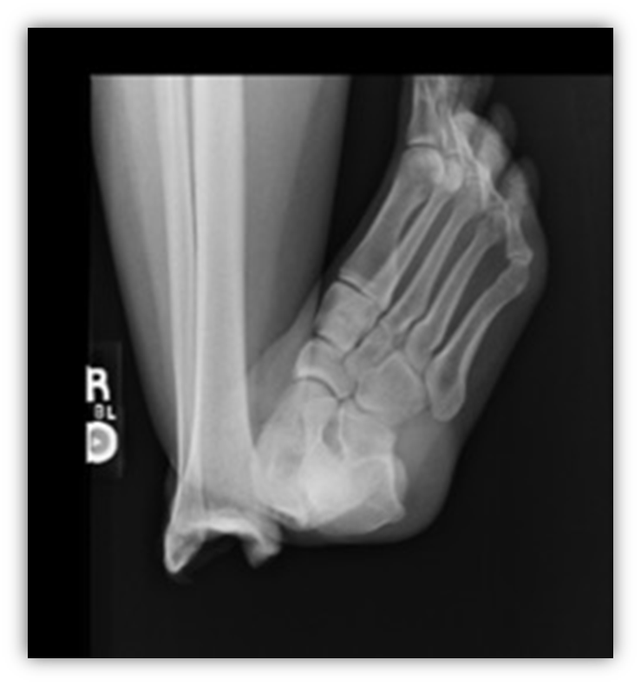
EMERGENT REDUCTION OF ANKLE DISLOCATIONS
Signs of compromise
Obvious deformity
Decreased or absent pulse
Delayed capillary refill
Cool to the touch
Pallor or cyanosis of the skin
Skin tenting
Decreased or absent sensation (paresthesia)
*Taken from a presentation created by Timothy R. Hurtado, DO, FACEP

Slide 7
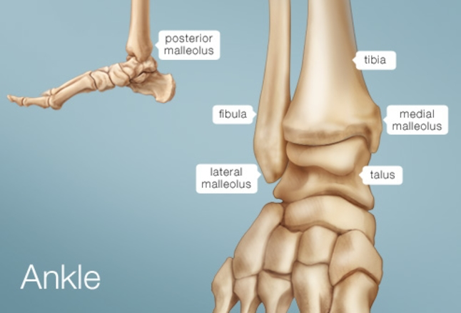
ANKLE ANATOMY
Notes:
Medial dislocations are most common. Most ankle reductions are not difficult, with return to the proper position preventing severe tissue damage and possible amputation.

Slide 8
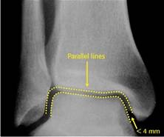
Goal of Ankle Reduction:
Anatomical alignment of the joint space
Relieve skin ischemia
Improve blood flow/pulse

Slide 9
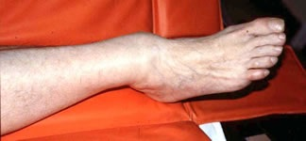
MEDIAL ANKLE DISLOCATION PRESENTATION
Blanching and area of potential skin ischemia

Slide 10
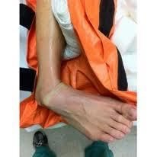
Lateral Ankle Dislocation Presentation
Note the obvious skin blanching

Slide 11
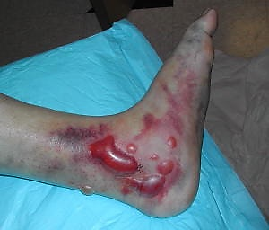
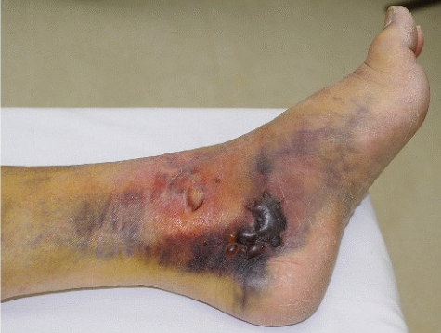
Skin ischemia and tissue necrosis caused by prolonged dislocation.
Severe tissue necrosis can lead to the need for amputation
Notes:
Skin ischemia and tissue necrosis caused by prolonged dislocation.
Severe tissue necrosis can lead to the need for amputation

Slide 12
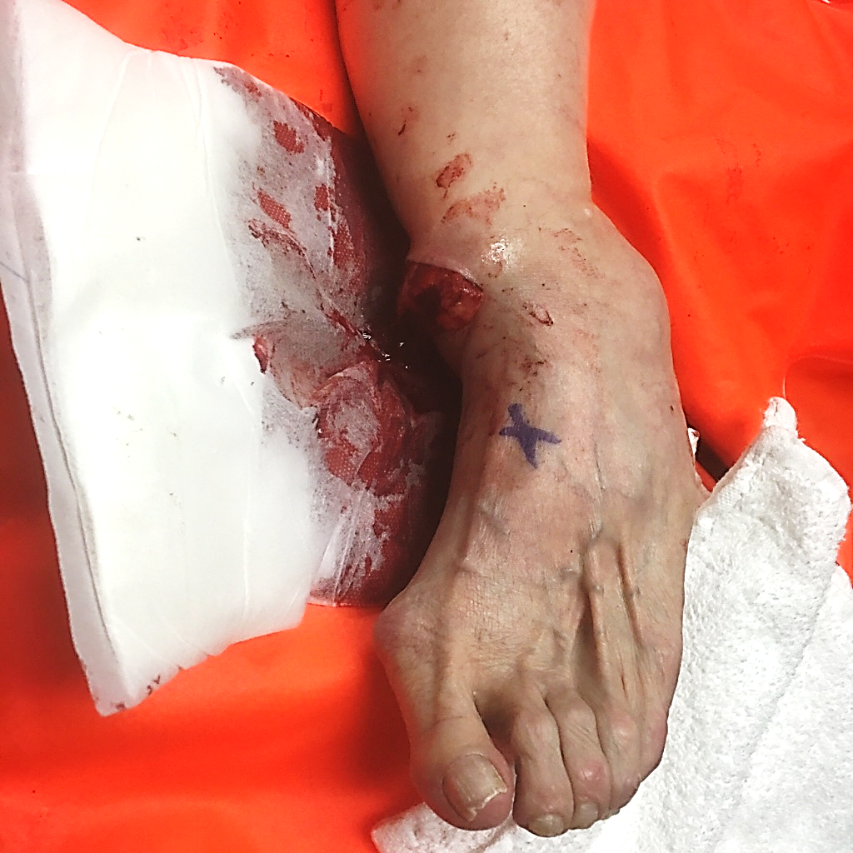
REDUCE?
Notes:
Again, 1 reduction attempt of an open dislocation is allowed in an emergent setting.

Slide 13
EMERGENT ANKLE REDUCTION TECHNIQUE
Notes:
Hand behind the heel, hand on top of the foot. Pull gentle, but firm axial traction and twist the foot towards the side of the dislocation.

Slide 14
WAIVERED (NON-EMERGENT) JOINT REDUCTIONS
All level of providers (EMR-paramedic) are waivered to reduce dislocated shoulders, patellas, fingers and toes without neurovascular compromise, if properly trained to do so.
Non-emergent reduction of OPEN dislocations is not allowed
Important assessments:
Time of dislocation/elapsed time since injury occurred
History of previous dislocations?
Continual monitoring of distal circulation, movement and sensation
Pre-and-post pain scales

Slide 15
WAIVERED JOINTS: KEY POINTS
Patient MUST agree to be transported to the hospital after reduction attempts
Prior to attempts, obtain patient’s informed consent, discuss risks of procedure:
Risk of recurrent dislocations
Damage to nerves, blood vessels, and surrounding tissue
Fractures
Failed reduction
Notes:
Benefits: easiest to reduce early after injury; reduced pain following successful reduction with improved patient condition, cooperation and ease of transport, reduced risk of neurovascular injury
Risks: include BUT ARE NOT LIMITED TO transiently increased pain, displaced bone fragments, potential to worsen neurovascular injury, failure to reduce, and bone, nerve, blood vessel, new bone, and muscular injury.

Slide 16
WAIVERED JOINTS: KEY POINTS
Maximum of 3 NON-EMERGENT Attempts
Proper immobilization in position of comfort can significantly reduce pain
Consider pain management before and after reduction attempts
Pain management includes basic skills like ice packs, ibuprofen/Tylenol, etc.
NO CONSCIOUS SEDATION! Opioids and benzos cannot be given simultaneously
Document all neuro and pain assessments pre-and-post procedure, all discussions with the patient, and report the procedure to your agency QA person

Slide 17
TIPS FOR SUCCESSFUL REDUCTIONS
Be gentle! Use slow movements when repositioning & apply slow, steady traction during reduction attempt.
Be patient. Many reductions can take 10-15 minutes or more.
Relaxation is key to most reductions. Patients relax at different speeds
STOP reduction attempt, if significantly increased pain or patient is resistant

Slide 18
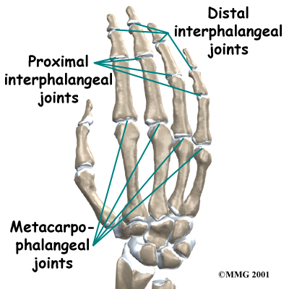
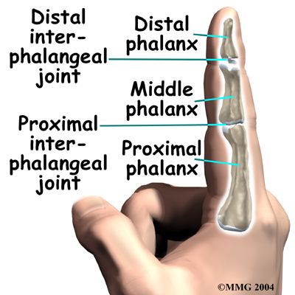
DIGIT ANATOMY: FINGERS
We are only waivered to reduce distal and proximal interphalangeal joints, NOT metacarpophalangeal joints!
Notes:
Is the thumb a finger?
The Oxford Dictionaries definition for finger is as follows: ‘each of the four slender jointed parts attached to either hand (or five, if the thumb is included)’. This wording implies that, while the thumb isn’t typically regarded as a finger, there is enough evidence of this use to include it in the definition. Although thumbs have certain similarities to fingers, there are some key differences. It’s therefore more accurate to describe a thumb as one of five digits that we have on each hand, rather than as a finger.
‘Digit’ is the technical term which covers fingers, thumbs, and toes in humans, and similar appendages in some animals. The thumb is the short, thick first digit of the human hand. The other four digits are our fingers.
What are the similarities and distinctions between the thumb and the four fingers? Some are obvious: all five digits on our hands are jointed and have nails on one surface of the uppermost joint, and a unique pattern of fingerprints (or thumbprints) on the other surface of that joint. However, the thumb only consists of one joint and two phalanges(bones), whereas the other four digits have two joints and three phalanges. The thumb is set lower on the hand and apart from the fingers. The thumbs of humans and other primates (such as chimpanzees) are opposable: we can move our thumb to face and touch the other digits of the same hand, which enables us to carry out a wide range of manual actions that animals with non-opposable digits are unable to perform.

Slide 19
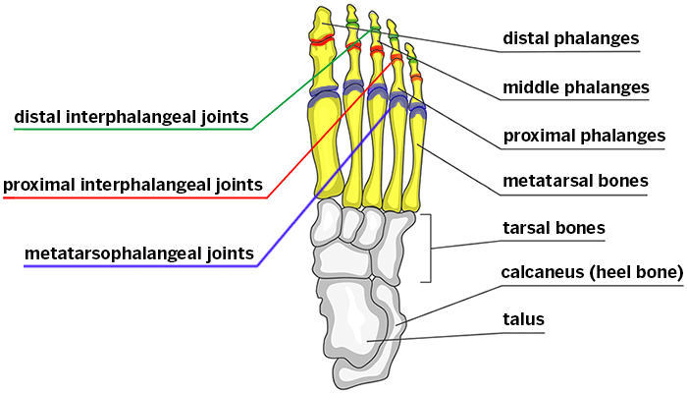
DIGIT ANATOMY: TOES
We are only waivered to reduce distal and proximal interphalangeal joints, NOT metatarsophalangeal joints!
Notes:
Is the thumb a finger?
The Oxford Dictionaries definition for finger is as follows: ‘each of the four slender jointed parts attached to either hand (or five, if the thumb is included)’. This wording implies that, while the thumb isn’t typically regarded as a finger, there is enough evidence of this use to include it in the definition. Although thumbs have certain similarities to fingers, there are some key differences. It’s therefore more accurate to describe a thumb as one of five digits that we have on each hand, rather than as a finger.
‘Digit’ is the technical term which covers fingers, thumbs, and toes in humans, and similar appendages in some animals. The thumb is the short, thick first digit of the human hand. The other four digits are our fingers.
What are the similarities and distinctions between the thumb and the four fingers? Some are obvious: all five digits on our hands are jointed and have nails on one surface of the uppermost joint, and a unique pattern of fingerprints (or thumbprints) on the other surface of that joint. However, the thumb only consists of one joint and two phalanges(bones), whereas the other four digits have two joints and three phalanges. The thumb is set lower on the hand and apart from the fingers. The thumbs of humans and other primates (such as chimpanzees) are opposable: we can move our thumb to face and touch the other digits of the same hand, which enables us to carry out a wide range of manual actions that animals with non-opposable digits are unable to perform.

Slide 20
FINGER DISLOCATION
Most commonly dislocated joint in the body is the proximal interphalangeal (PIP) joint

Slide 21
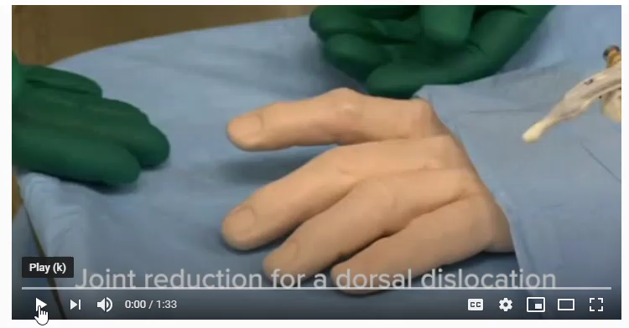
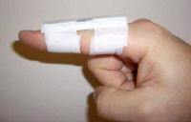
FINGER REDUCTION
Assess pre-&-post CMS
Pull steady, gentle axial traction until reduced
Buddy tape or splint
Notes:
Don’t reduce open injuries or obvious fractures

Slide 22
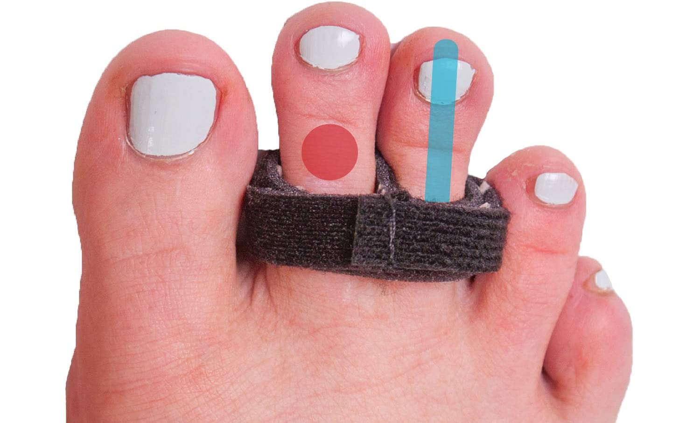
TOE REDUCTION
Assess pre-&-post CMS
Pull steady, gentle traction until reduced
Buddy tape or splint

Slide 23
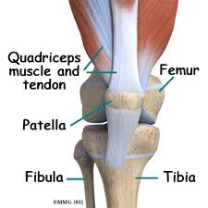
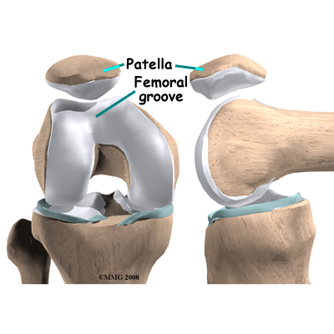
ANATOMY: THE PATELLA

Slide 24
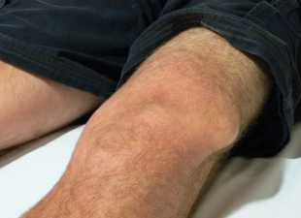
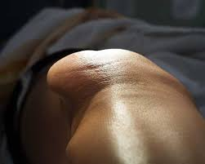
PATELLAR DISLOCATION
Most common in ages 16-20
Usually sports-related
Women at higher risk than men, as well as patients with connective tissue diseases

Slide 25
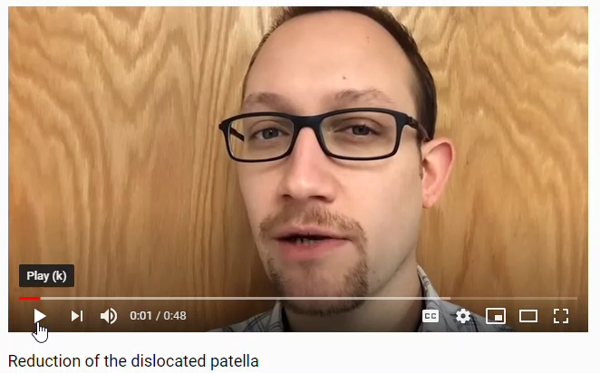
PATELLAR REDUCTION
The patient may walk with a splint in place (knee immobilizer, foam roll like a sleeping pad, etc.) after the reduction
This is helpful in remote settings, when evacuation is needed.
Notes:
Most commonly dislocated laterally.
Flex the hip and knee while applying gentle traction to the lower leg.
May need gentle sideways pressure on the patella pushing in the direction of attempted reduction.
Immobilize knee with straight-leg immobilizer/splint after reduction.
If reduction unsuccessful, splint in position of comfort, manage pain, and transport.

Slide 26
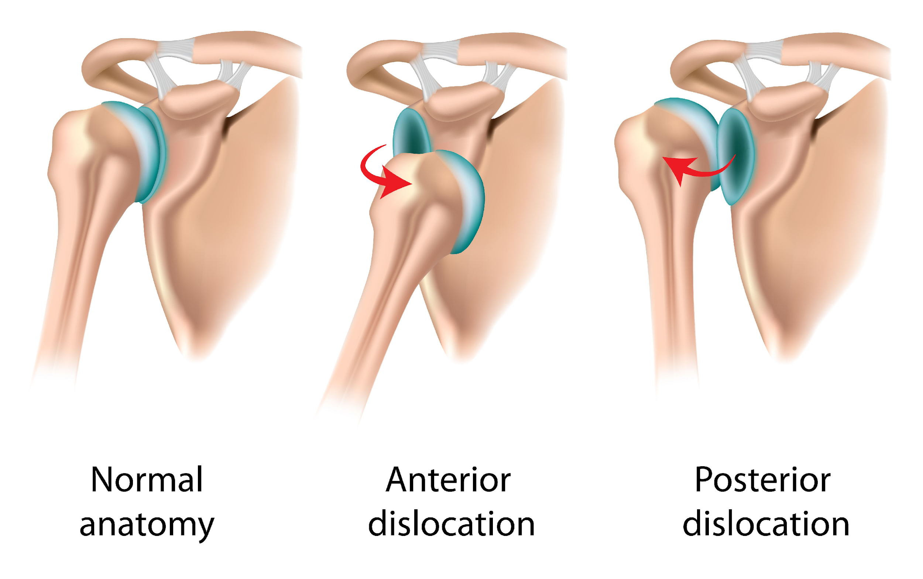
SHOULDER DISLOCATION
Anterior and anteroinferior dislocations accounts for approximately 90-95% of all shoulder dislocations
Posterior dislocations occur approximately 5-10% of the time.
Most commonly caused by
severe seizures or electrocution
Posterior dislocations SHOULD
NOT be reduced in the field!
Notes:
The most commonly dislocated large joint is the shoulder. It is a particularly important pathology to be able to recognize in the field due to the prevalence of the injury as well as the high recurrence rate. Around 95% of shoulder dislocations are anterior, and approximately half of patients develop recurrent shoulder dislocations within 2 years.[8] It is characterized by a complete anterior displacement of the humeral head from the glenoid. It often presents with the arm abducted and externally rotated and a loss of rounded shoulder appearance. In around 5% of shoulder dislocations, patients can develop axillary nerve neuropraxia, which consists of a reduced sensation over the lateral shoulder.[8]
Elderly patients are more likely to fracture bone than dislocate joints.

Slide 27
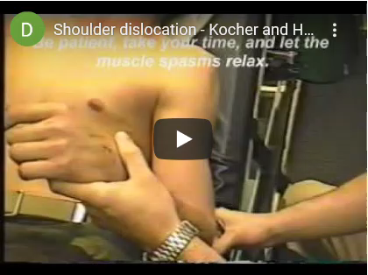
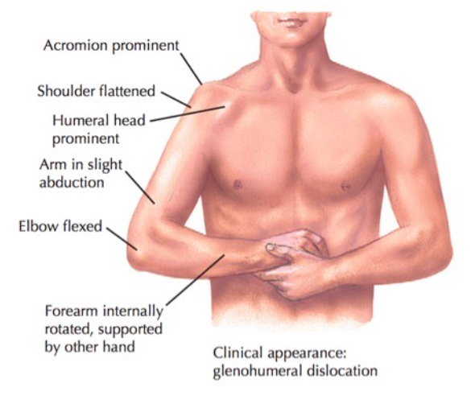
REDUCTION METHOD: HENNEPIN
Notes:
Hold arm in next to chest wall.

Slide 28
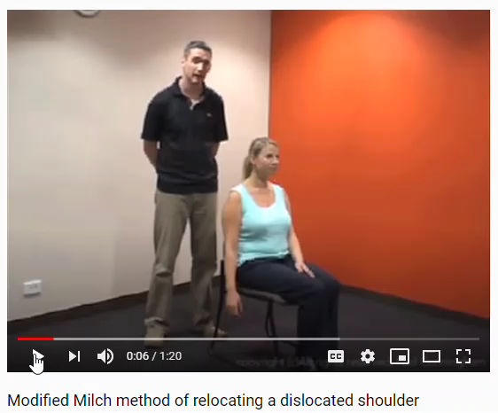
REDUCTION METHOD: MODIFIED MILCH

Slide 29
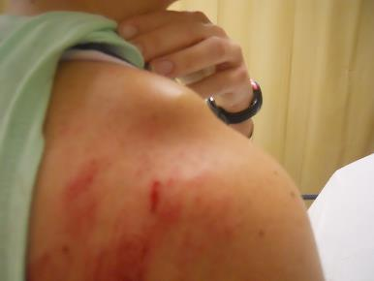
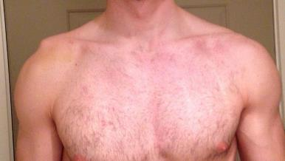
FRACTURES & SEPARATIONS
If patient has extreme pain with reduction techniques, STOP!
Consider possible AC dislocation, clavicle fracture or proximal humerus fracture
Elderly patients are more likely to fracture than dislocate
Remember: No more than 3 NON-EMERGENT attempts
Immobilize arm in position of comfort with sling and swathe
Notes:
Document CMS, especially the outer aspect of the shoulder.

Slide 30
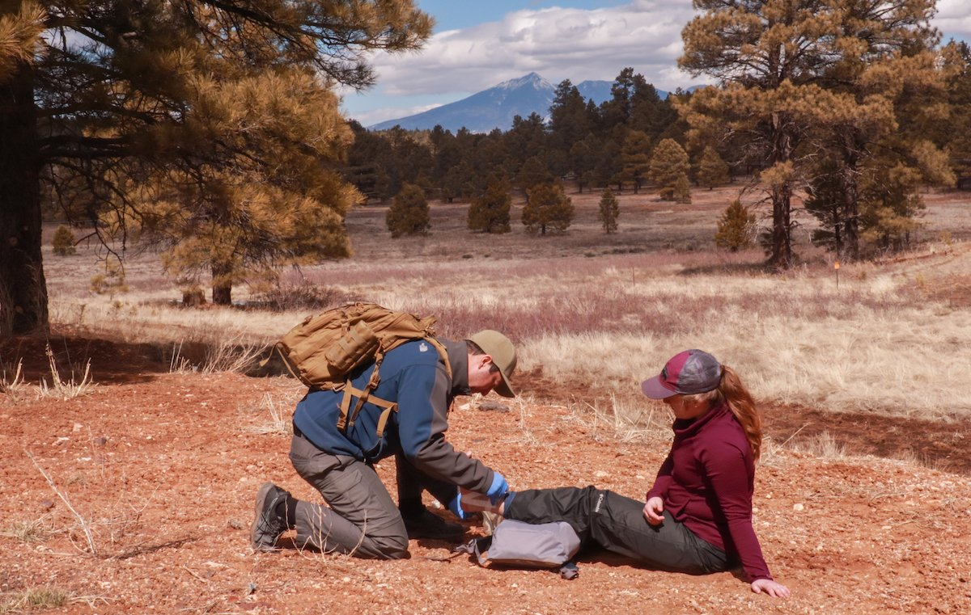

Slide 31
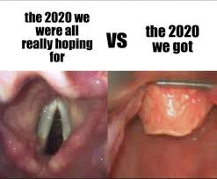
MAAM Review

Slide 32
WHY DO WE RSI??
Medication Error
Inability to Intubate
Reduces Instance of Aspiration
Relaxes Airway Structure
sdfasdfsdsdasd

Slide 33
MAAM
Indication:
Respiratory Arrest/Impending
Inability to Protect Airway
Potential For Airway Compromise
Intact Gag Reflex
Trismus
3 Questions: (SELECTION CRITERIA)
Can I achieve a good face seal?
Is the Airway Patent
Do I think I can place an advanced airway in this patient?
Contraindication:
Allergy/Absolute Contraindication of induction agent medications
< Age 13
No Gag Reflex Present
Patients who DO NOT meet selection criteria

Slide 34
MAAM - SPECIAL CONSIDERATIONS:

Slide 35
Please
Review

Slide 36
Please
Review

Slide 37
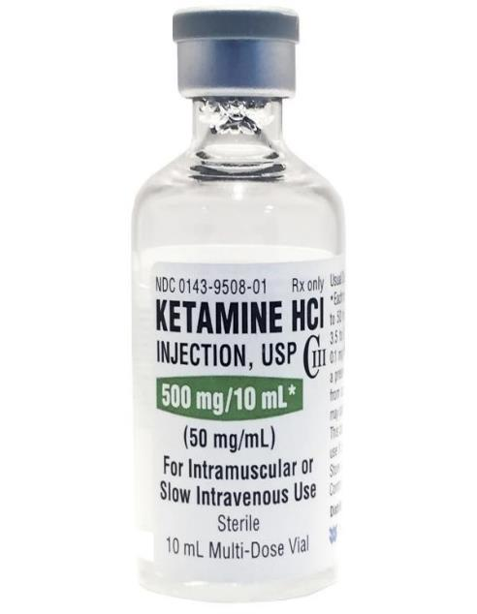
INDUCTION – KETAMINE
Initial Dose:
2mg/kg IV/ IO
Max Dose: 200mg
Re-Dose:
0.5mg/Kg IV/IO
Max Dose: 3mg/kg/hr
Max Single Dose: 100mg
Repeat As Needed Every 10 Mintes

Slide 38
INDUCTION - KETAMINE
Special
Consideration
Indication
Contra-Indication
Hypersalivation
Muscle Fasciculation
Induction Agent For MAAM
Post-Procedure Sedative
Known Hypersensitivity
Age < 13 Years

Slide 39
INDUCTION - KETAMINE
Onset:
~30 Seconds IV
Duration:
10 to 15 Minutes
Re-Sedation:
Every 10 to 15 Minutes IV
*Remember to Maintain Sedation*

Slide 40
PARALYTIC - ROCURONIUM:
*FIRST LINE Paralytic in MAAM
Non-Depolarizing Neuromuscular Blocker
1mg/kg
Max Dose: 100mg

Slide 41
Please
Review

Slide 42
PARALYTIC – SUCCINYLCHOLINE
*2nd Line Paralytic in MAAM
Skeletal Muscle Relaxant
2mg/kg IV/IO
Max Dose 200mg
No Repeat Dose

Slide 43
Please
Review

Slide 44
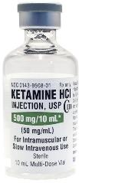
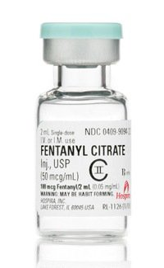
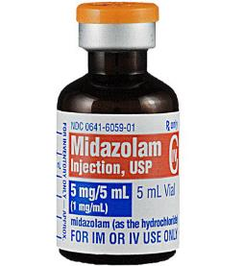
MAAM - RESEDATION
Or
+
+

Slide 45
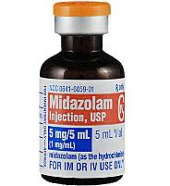
2mg IV/IO
Max Single Dose: 100mg
5mg IV/IO
Max Single Dose: 100mg
50-100mcgs
Or
+

Slide 46
Laminated Pocket Cards Available

Slide 47
MAAM – STEP BY STEP
1.) Address 5 Questions With Group
2.) Complete Checklist
2.) Sedate
3.) **PreOxygenate
4.) Paralyze
5.) Intubate
6.) **Re-Sedate**

Slide 48
MAAM – STEP BY STEP
1.) Address 5 Questions With Group
2.) Complete Checklist
2.) Sedate/Induce
3.) **PreOxygenate
4.) Paralyze
5.) Intubate
6.) **Re-Sedate**

Slide 49
MAAM – STEP BY STEP
1.) Address 5 Questions With Group
2.) Complete Checklist
2.) Sedate
3.) PreOxygenate
4.) Paralyze
5.) Intubate
6.) **Re-Sedate**
Apneic Oxygenation
3 Minutes
> 95%, NC or NRB
< 95%: Provide PPV or CPAP if indicated)

Slide 50
MAAM – STEP BY STEP
1.) Address 5 Questions With Group
2.) Complete Checklist
2.) Sedate
3.) PreOxygenate
4.) Paralyze
5.) Intubate
6.) **Re-Sedate**

Slide 51
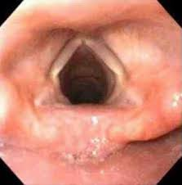
MAAM – STEP BY STEP
1.) Address 5 Questions With Group
2.) Complete Checklist
2.) Sedate
3.) PreOxygenate
4.) Paralyze
5.) Intubate
6.) Post Checklist
7.) **Re-Sedate**

Slide 52
MAAM – STEP BY STEP
1.) Address 5 Questions With Group
2.) Complete Checklist
2.) Sedate
3.) **PreOxygenate
4.) Paralyze
5.) Intubate
6.) Post Checklist
6.) **Re-Sedate**

Slide 53
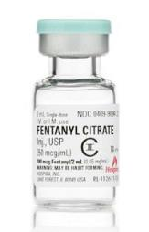
MAAM – STEP BY STEP
1.) Address 5 Questions With Group
2.) Complete Checklist
2.) Sedate
3.) **PreOxygenate
4.) Paralyze
5.) Intubate
6.) Post Checklist
6.) **Re-Sedate**

Slide 54
TRANEXAMIC ACID

Slide 55
TRANEXAMIC ACID
Antifibrinolytic
Decreases the conversion of plasminogen to plasmin, thus preventing Fibrin breakdown
This is the step that is blocked by TXA

Slide 56
TRANEXAMIC ACID
Hemorrhage:
Paramedic ONLY
Adult: 2gms IV/IO (Slow)
Peds: 30mgs/kg (Max: 2gms)
Epistaxis:
EMT/Paramedic
Adult: 250mg on Gauze/4x4 (per nare)
Peds: 100mgs on Guaze/4x4

Slide 57
TRANEXAMIC ACID:
Contraindication
Potential
Adverse Reaction
Special
Precaution
- Time of Hemorrhage
>3 hrs.
- Isolated Head Injury
- Color/Vision Disturbance
- N/V, Diarrhea
- Required Monitoring: Heart rate, B/P, Respiration Rate
- Known Renal Insufficiency
- Assure Receiving Facility
is notified of administration
- Know PE/DVT
- Know GI Bleed
- Allergic Reaction
- Thrombotic Event
- If 1gm is infused by a sending facility, a 2nd gm may be administered in a 50cc bag of Saline over 10 minutes

